Slide 1
CS 4360: CubeSat Presentation
Justin Figueredo
Lucas Nieddu
Logan St. Cyr
Victoria Crowley

Slide 2
Previous Sprint: Research, deliverables, roles assigned (Sprint 0)
Exited Project Planning phase
Moved to a realistic deliverable as a balloon “satellite”
Secured two raspberry pi units
Transmission unit
Ground Station
Contacted Amateur Radio Club for launch of transmission unit
Received two radios from York Space Systems to transmit signals between the two devices
Continued seeking funding through AIAA, AES, and CTE Mission: CubeSat
Set up project tracking with toggl and trello

Slide 3
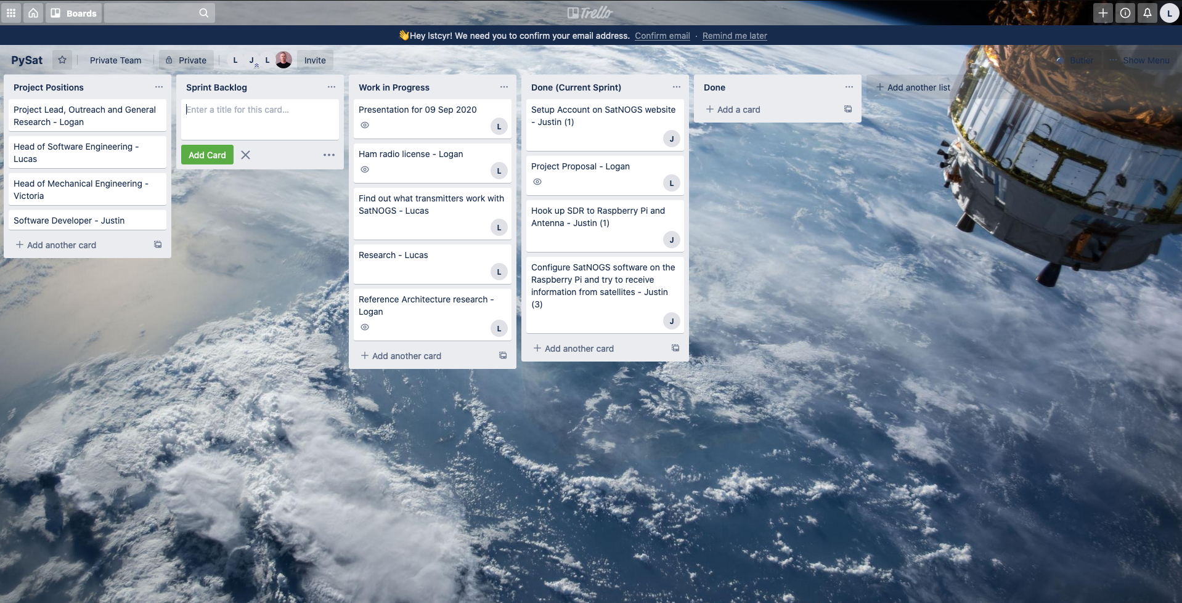
Trello

Slide 4

Toggl

Slide 5
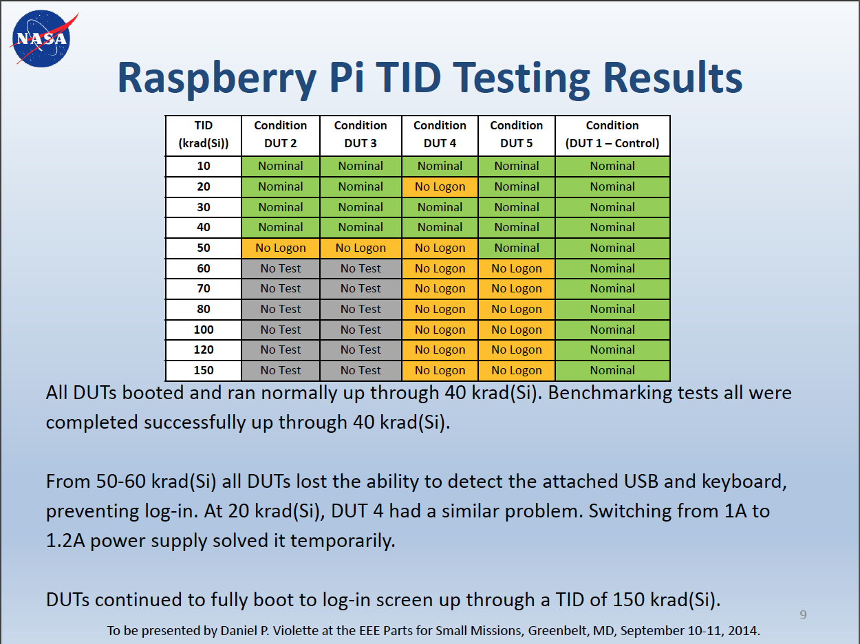
Previous Sprint: Research, deliverables, roles assigned (Sprint 0)
Arduino/Raspberry Pi: Hobbyist Hardware and Radiation Total Dose Degradation
Pi-Sat: A Low-Cost Small Satellite and Distributed Mission Test Platform
CubeSat101: Basic Concepts and Processes for First-Time CubeSat Developers

Slide 6
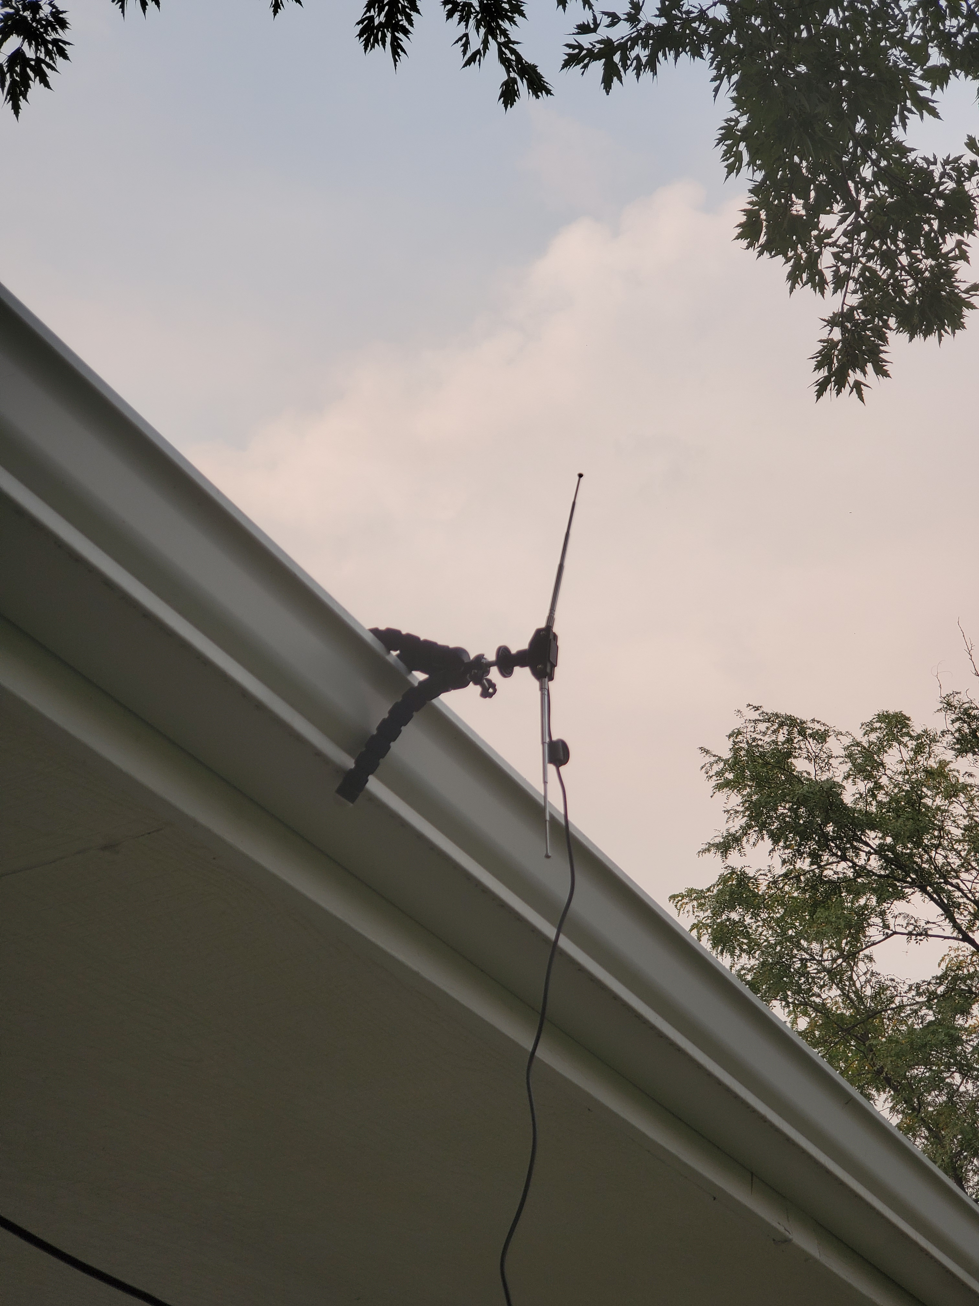
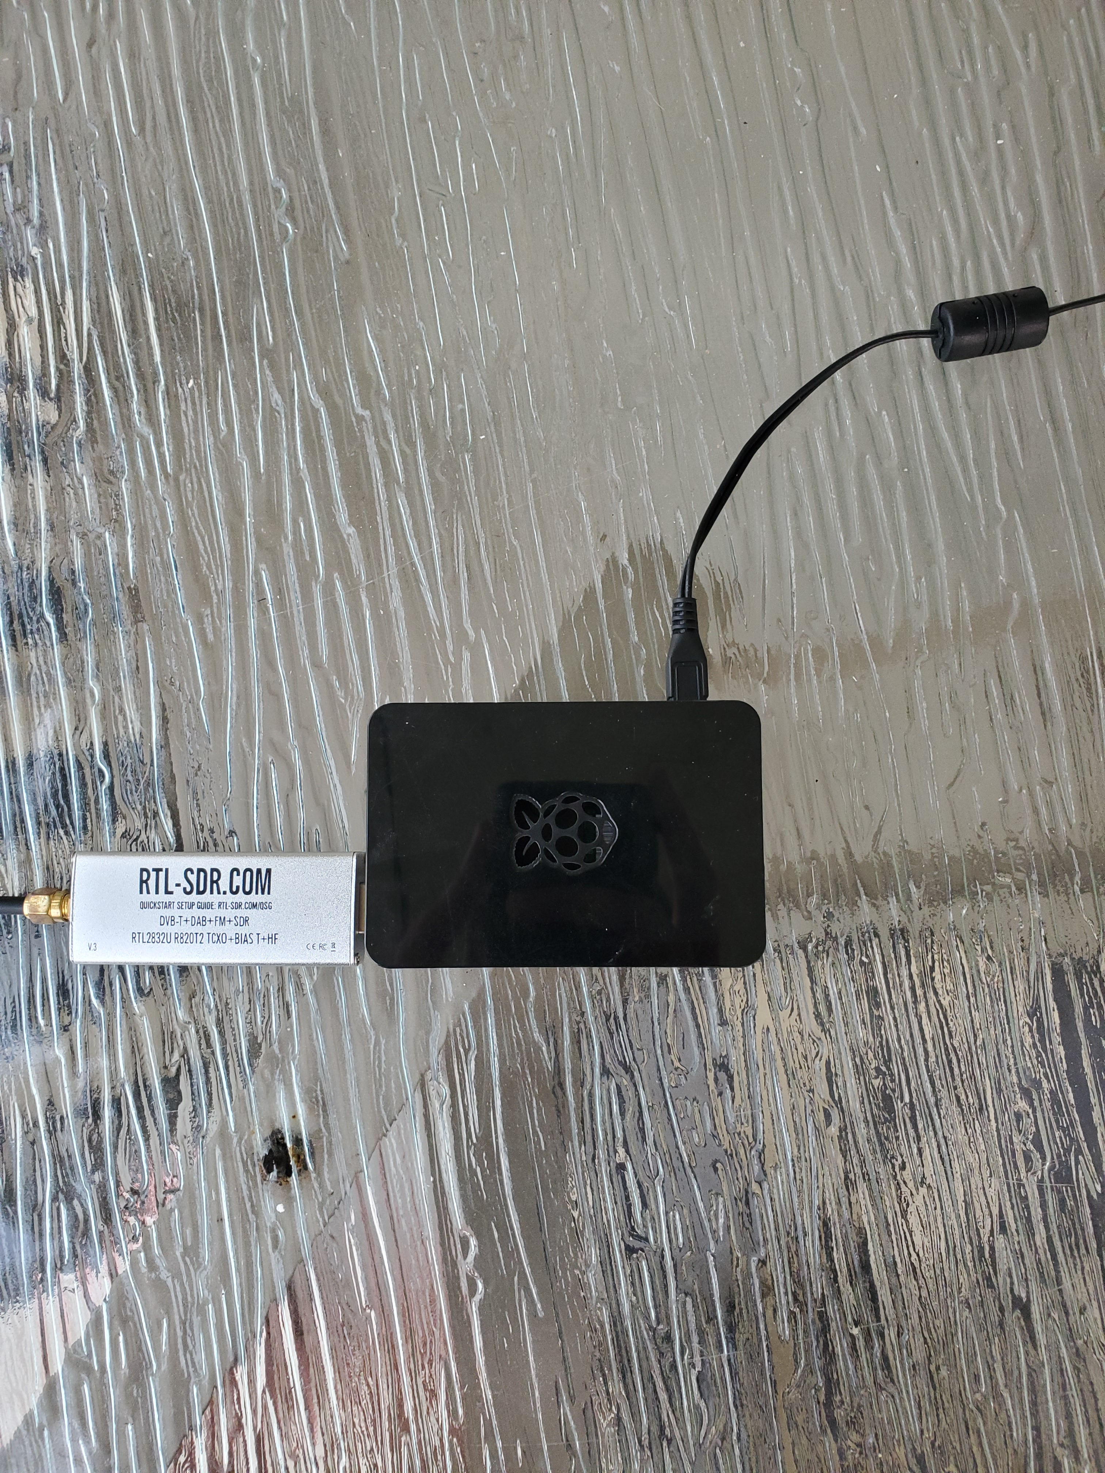
Current Sprint: Ground System with SatNOGS software (Sprint 1) cont.
Ground System setup by Justin to connect through SatNOGS API to receive a satellite signal

Slide 7
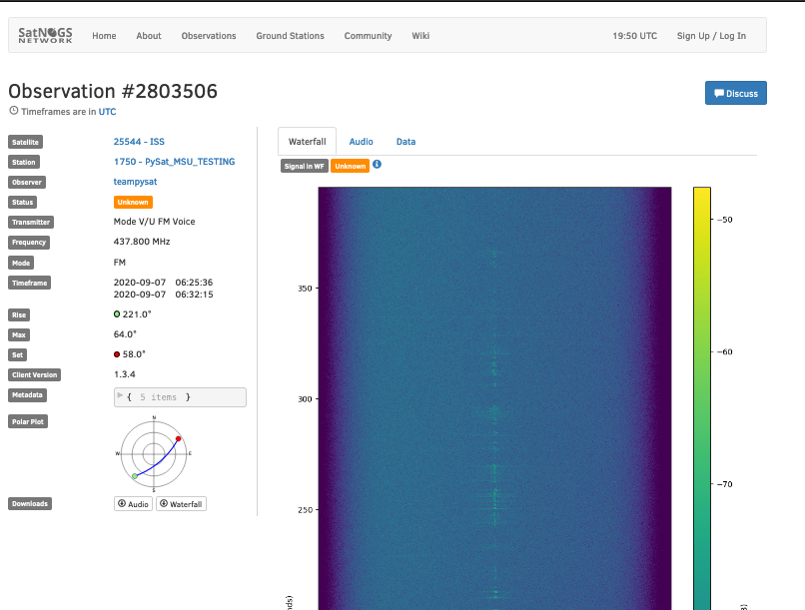
Current Sprint: Ground System with SatNOGS software (Sprint 1)
SatNOG software installation and observation
A global network of satellite ground stations, designed as an open source participatory project.

Slide 8
Current Sprint: Ground System with SatNOGS software (Sprint 1) cont.
Logan is taking over the required Technician License radio license to ensure that the team can launch the first test of long-range communication during the launch in October
http://www.arrl.org/ham-radio-licenses
Met and agreed to launch with Randall Owen from MSU Denver AES department

Slide 9
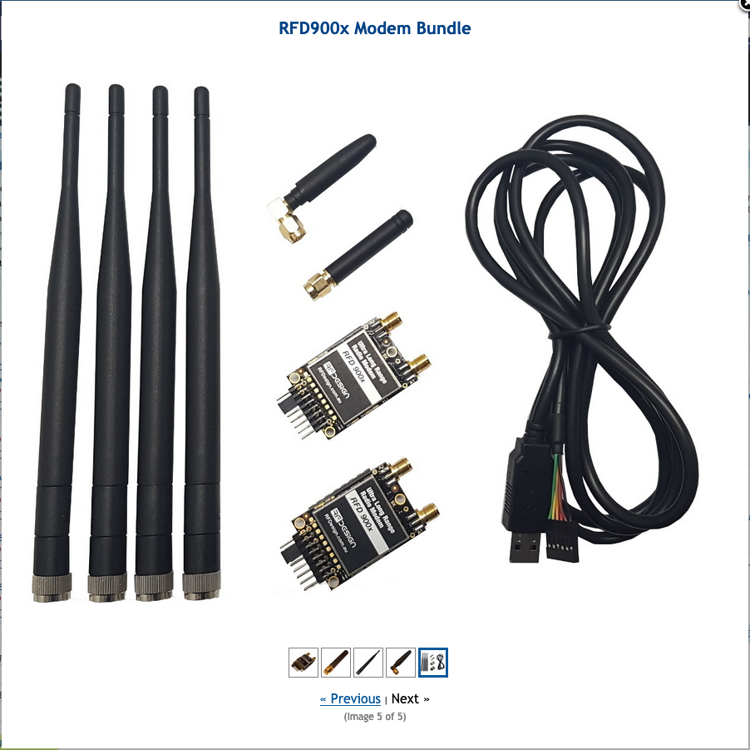
Preparing For Next Sprint: Ground System with Ham radio integration
Acquired RFD900x Modem Bundle from Peter Hufford at York Space Systems
Frequency Range: 902 - 928 MHz (USA) / 915 - 928 MHz (Australia)
Output Power: 1W (+30dBm), controllable in 1dB steps
The software solution is an open source development called "SiK".

